Slide 1

Building a Better Data Matcher
Using Tokenization & Open Source Libraries to Match Entities and Identify Duplicates
Duncan Bell, Association TRENDS

Slide 2
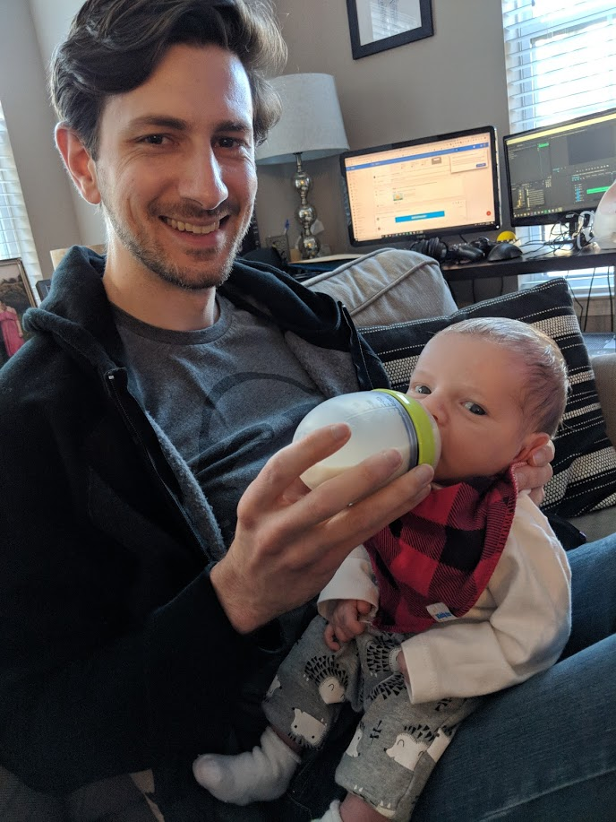
About Me

Slide 3
Agenda
What is data matching and why do we care?
Why data matching is challenging
Common approaches to data matching
The tokenization approach to matching
Applications and results
Planned improvements
Questions

Slide 4
What is Data Matching & Why Do We Care?
Data Matching: Linking of records (usually organizations or contacts) which reside in data silos or otherwise do not have an available key/unique ID
What is it?
Merge records rather than create duplicates
Append data from one database to another
Quickly becomes inefficient without an intelligent approach
Why do we care?

Slide 5
Why data matching is challenging
Normal deviations in data entry
Speling errors
Abbreviations/acronyms
Alternate names/nicknames
Non-standardized data structures
E.g. Addresses stored in a single cell versus add1 | city | state | zip
Mingled data types/formats
E.g. Person name stored in organization name column
Incomplete, inaccurate, or misleading data
Most of which is easy for a human to handle – but difficult for a machine!

Slide 6
Let’s look at some examples:
Dataset 1
Dataset 2
Field | Value
Organization_id | 24543
Organization_name | Independence 1st
Bus_type | Nonprofit
Address1
Address2
City | Milwaukee
State | WI
Postal_code
Phone | 321-445-7321
Website | independencefirst.org
Revenue_value | 3109746
Field | Value
EIN | 873234509
OrganizationName | INDEPENDENCEFIRST INC
AddressTxt | 1123 Curtis Ln. Milwaukee WI
Phone
URL | http://independencefirst.org

Slide 7
Let’s look at some examples:
Dataset 1
Dataset 2
Field | Value
Organization_id | 24543
Organization_name | Independence 1st
Bus_type | Nonprofit
Address1
Address2
City | Milwaukee
State | WI
Postal_code
Phone | 321-445-7321
Website | independencefirst.org
Revenue_value | 3109746
Field | Value
EIN | 873234509
OrganizationName | INDEPENDENCEFIRST INC
AddressTxt | 1123 Curtis Ln. Milwaukee WI
Phone
URL | http://independencefirst.org

Slide 8
Let’s look at some examples:
Dataset 1
Dataset 2
Field | Value
Organization_id | 7654
Organization_name | SEIU Local 925
Bus_type | Union
Address1 | 123 Union Blvd.
Address2 | Suite 300
City | Seattle
State | WA
Postal_code | 09283
Phone | 543-234-4564
Website | Seiu925.org
Revenue_value | 13004
Field | Value
EIN | 629888731
OrganizationName | SERVICE EMPLOYEES INTERNATOINAL UNION LOCAL 925
AddressTxt
Phone | +1 (543) 234-4564 x234
URL

Slide 9
Let’s look at some examples:
Dataset 1
Dataset 2
Field | Value
Organization_id | 7654
Organization_name | SEIU Local 925
Bus_type | Union
Address1 | 123 Union Blvd.
Address2 | Suite 300
City | Seattle
State | WA
Postal_code | 09283
Phone | 543-234-4564
Website | Seiu925.org
Revenue_value | 13004
Field | Value
EIN | 629888731
OrganizationName | SERVICE EMPLOYEES INTERNATOINAL UNION LOCAL 925
AddressTxt
Phone | +1 (543) 234-4564 x234
URL

Slide 10
Let’s look at some examples:
Dataset 1
Dataset 2
Field | Value
Organization_id | 13444
Organization_name | Texas Association of Optometrists
Bus_type | Association
Address1 | 333 Eyeball Rd.
Address2
City | Austin
State | TX
Postal_code | 97463
Phone
Website | tei.org
Revenue_value | 201223
Field | Value
OrgID | 138
OrgName | TX OPTOMETRIC ASSOCIATOIN INC
Address1Txt | Eyeball Rd.
Address2Txt
CityTxt
State | Austin
Zip
Phone
URL

Slide 11
Let’s look at some examples:
Dataset 1
Dataset 2
Field | Value
Organization_id | 13444
Organization_name | Texas Association of Optometrists
Bus_type | Association
Address1 | 333 Eyeball Rd.
Address2
City | Austin
State | TX
Postal_code | 97463
Phone
Website | tei.org
Revenue_value | 201223
Field | Value
OrgID | 138
OrgName | TX OPTOMETRIC ASSOCIATOIN INC
Address1Txt | Eyeball Rd.
Address2Txt
CityTxt
State | Austin
Zip
Phone
URL

Slide 12
How do we match?
Manual
Most accurate BUT very slow and requires a human
Exact match using VLOOKUP
Will catch low-hanging fruit quickly BUT will miss any spelling deviation
Fuzzy match using edit-distance algorithms
Ex: Fuzzy Lookup Add-In for Excel
Now you’re catching spelling deviations BUT computationally expensive
Distill to match candidates using tokens, then score matches
Scales well with large data, can be folded into automation
Accurate and efficient, though still requires humans to review exceptions

Slide 13
Token Matching With Python
Python via Anaconda environment, Jupyter notebooks
Note: for implementation in enterprise workflows, dynamic cloud computing like Apache Spark will be more appropriate than Pandas
Key Libraries:
Pandas – Efficient data manipulation, SQL-like joins
Re (regular expressions) – used for parsing data, preprocessing
CountVectorizer (sklearn) – tokenizer, optimized for text data
Counter (Collections) – simple token counter for creating filters
Fuzz (fuzzywuzzy) – edit distance string comparison package
jaro_winkler (jellyfish) – another edit distance algorithm
py_common_subseq – used to compare matched postal codes and phone numbers
LogisticRegression (sklearn) – linear regression for probabilistic scoring

Slide 14
Distill Matches To Minimum Threshold
Source Databases
Pre-Processing
Pool & Count Unique Tokens
Join datasets on shared tokens
Score Matches
1
Clean
Standardize
Derive
2
Clean
Standardize
Derive

Slide 16
Distill Matches To Minimum Threshold
Source Databases
Pre-Processing
Pool & Count Unique Tokens
Join datasets on shared tokens
Score Matches
1
Clean
Standardize
Derive
Isolate & Exclude Frequently Occurring Tokens
Identify & Signal-Boost More Unique Tokens
2
Clean
Standardize
Derive

Slide 17
Example Tokenized Records
Left_Org_ID | Token
13444 | texas
13444 | optometrists
13444 | 333
13444 | eyeball
13444 | austin
13444 | tx
13444 | 97463
13444 | tei
Right_Org_ID | Token
138 | tx
138 | optometric
138 | associatoin
138 | eyeball
138 | austin
Excluded tokens: inc, rd
Excluded tokens: association, of, rd, org

Slide 18
Distill Matches To Minimum Threshold
Source Databases
Pre-Processing
Pool & Count Unique Tokens
Join datasets on shared tokens
Score Matches
1
Clean
Standardize
Derive
Isolate & Exclude Frequently Occurring Tokens
Identify & Signal-Boost More Unique Tokens
Chunk
your
Match candidates distilled based on minimum number of shared tokens
data
to
2
Clean
Standardize
Derive
save
memory

Slide 19
If we have two datasets of 88k & 226k records:
22,255,906 matches sharing 1 token
2,867,198 matches having 2 or more shared tokens
Matches

Slide 20
Distill Matches To Minimum Threshold
Source Databases
Pre-Processing
Pool & Count Unique Tokens
Join datasets on shared tokens
Score Matches
1
Clean
Standardize
Derive
Isolate & Exclude Frequently Occurring Tokens
Identify & Signal-Boost More Unique Tokens
Chunk
your
Match candidates distilled based on minimum number of shared tokens
Name similarity Name uniqueness, State,
Postal, Phone, Domain
data
to
2
Clean
Standardize
Derive
save
memory

Slide 21
Features Used for Match Scoring
Org name similarity via edit distance algorithms (fuzzy matching):
Jaro-Winkler & Levenshtein
Org name uniqueness
Of shared tokens between names, are tokens common or rare?
Count total number of shared tokens
State match
Postal code match
Phone match
Web domain match

Slide 22
Weighted vs Probabilistic Scoring
Features can be weighted according to match importance
Ex: Domain match is more important than state match
However weights are assigned somewhat arbitrarily
How much more important is domain match than state match?
Probabilistic scoring via logistic regression is better
Requires labeled training data
Features mathematically tuned by machine to optimize prediction accuracy
Can be tuned to test feature configurations using train_test_split and cross_validation in sklearn

Slide 23
Can we use this to find duplicates?
YES

Slide 24
Distill Duplicates To Minimum Threshold
Source Database
Pre-Processing
Pool & Count Unique Tokens
Join records on shared tokens
Score Duplicates
Isolate & Exclude Frequently Occurring Tokens
Identify & Signal-Boost More Unique Tokens
Chunk
Duplicate candidates distilled to minimum token threshold
&
Matches to self excluded
your
Name similarity Name uniqueness, State,
Postal, Phone, Domain
1
Clean
Standardize
Derive
data
to
save
memory

Slide 25
Recent results
Matching project:
Client database of ~100k records
IRS 990 database of ~300k records
~20k existing matches confirmed & ~5k new matches identified
De-Duplication project:
Dataset of ~1.6 million federal & private grant recipients
~100k duplicate pairs identified via tokenization process
This approach saved us staff time and improved data quality

Slide 26
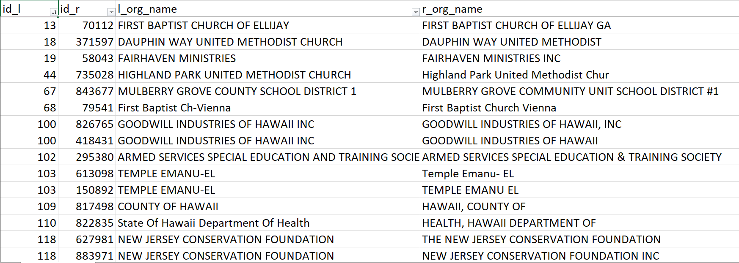
Example output:

Slide 27
Planned Improvements
More robust pre-processing
Phonetization of tokens (both “Robert” and “Rupert” become “R163”)
Known libraries: Metaphone, Soundex
Prediction of acronyms (“National Institute of Health” = NIH)
Standardization of common abbreviations (“Assn” = “Association”)
Enhance features & training data
Shared first initial
Shared acronym
Shared regional/subdivision keyword (e.g. “chapter”, state name)
Contact matching
Handle nicknames, maiden names, prefix/suffix
Matched contacts work for same/related org?

Slide 28
Conclusion
Data matching is both a vital business activity and a drain on staff
Using code and open source libraries we can approximate human logic so machine can do heavy lifting – and we “set and forget”
Code can be re-used
Not appropriate for every organization and situation, but essential for any large project

Slide 29

Questions?

Slide 30
Appendix
Birthday paradox https://betterexplained.com/articles/understanding-the-birthday-paradox/

